Slide 1














Project: RA014:
Group 06
Multivariate Regression For Movie Revenue Prediction
Multivariate Regression For Movie Revenue Prediction

Slide 2











Team member
Lun Tola e20200254
Sang Rithpork e20200232
Thornthea Gechhai e20201321
Thy Nary e20200265
Leat Seanglong e20200971

Slide 3

Contents
01
INTRODUCTION
EXPLORATORY DATA ANALYSIS (EDA)
03
Data analysis
02
04 Methodology and Model
05
Model Selection
06
Conclution

Slide 4
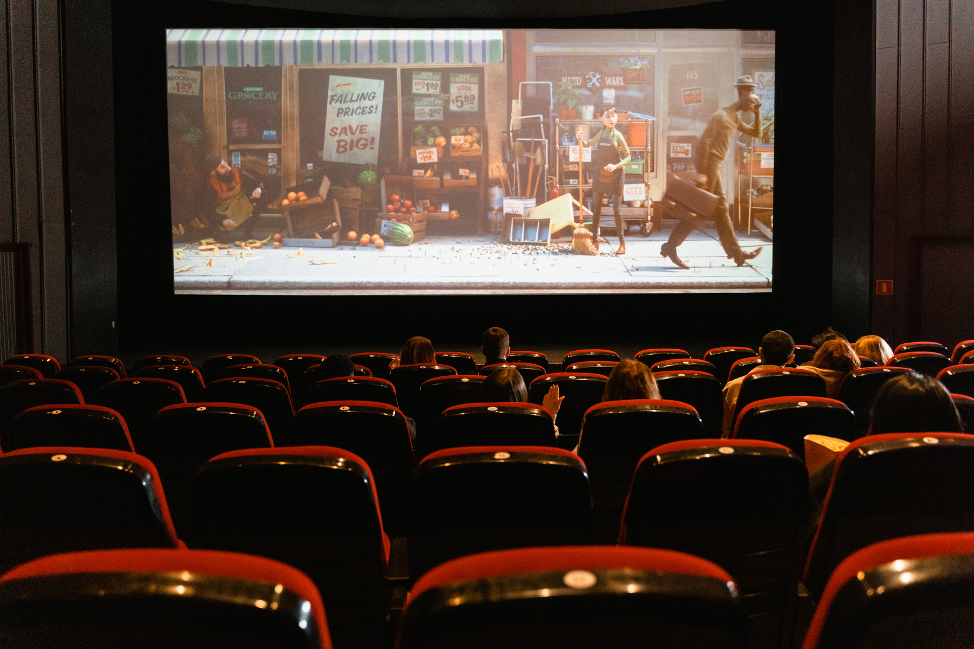

1. Introduction

Slide 5





The TMDB 5000 Movie Dataset is a collection of data about movies, including information about the movie's budget, revenue, popularity, runtime, release date, cast, crew, and genres. It was compiled by scraping data from The Movie Database (TMDB), a popular online database of movie information.
The dataset contains 4076 movies and 8 variables, including both numerical and categorical variables.
Language programming for this project is Python

Slide 6



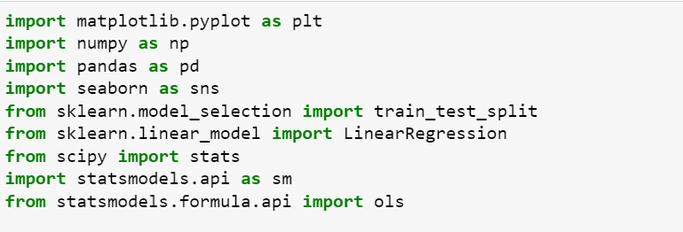





Library for this project

Slide 7
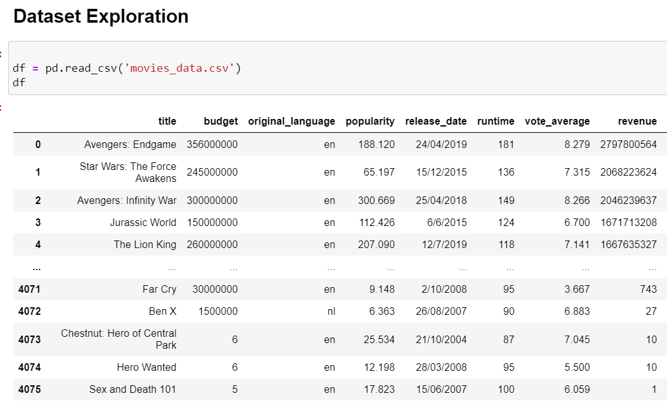
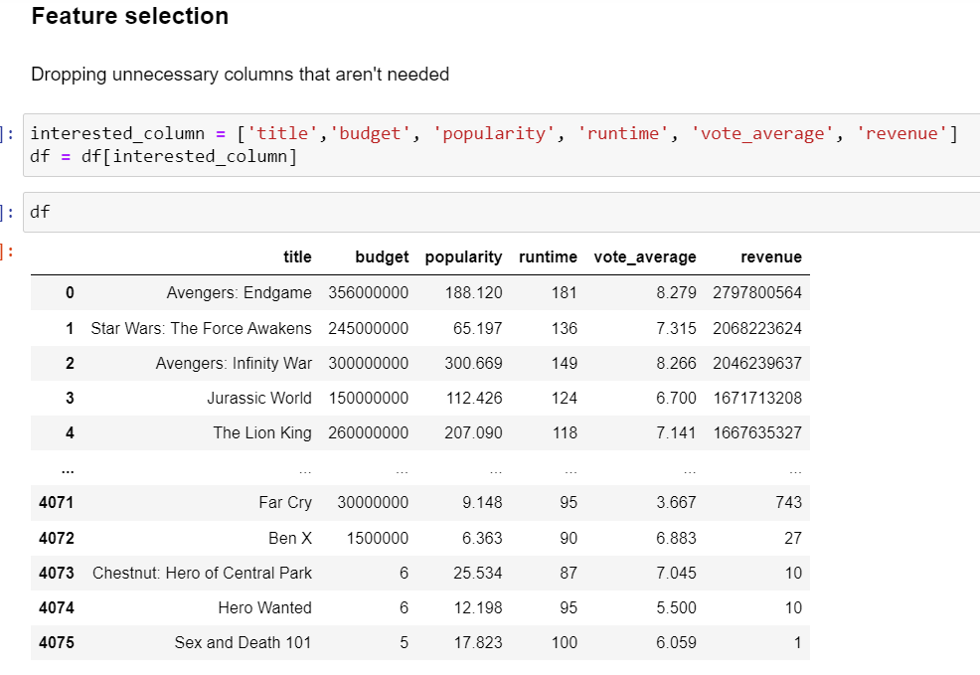

Slide 8


02
EXPLORATORY DATA ANALYSIS (EDA)

Slide 9
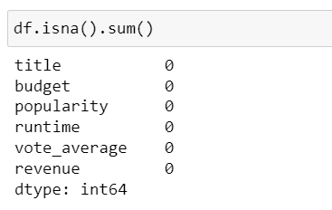

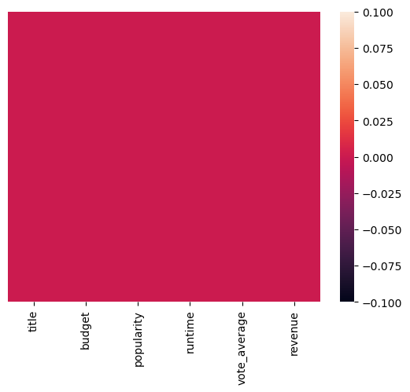
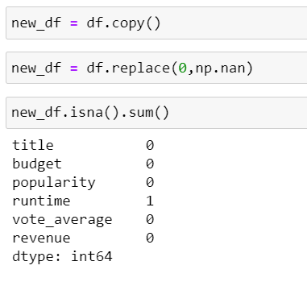

Data cleaning
Missing value
There no missing value when we checked it for first time.since some data contain a 0 value which is a misinfomation that was scraped into the data so we count it as a missing value also.

Slide 10
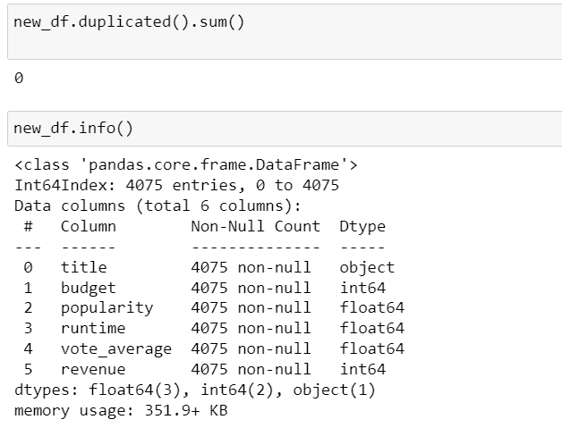
Duplicates data

Slide 11


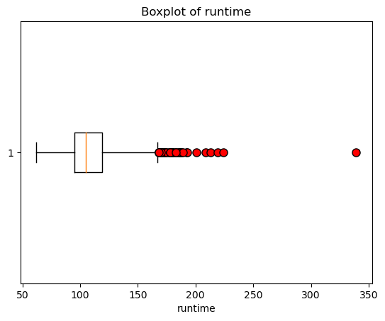
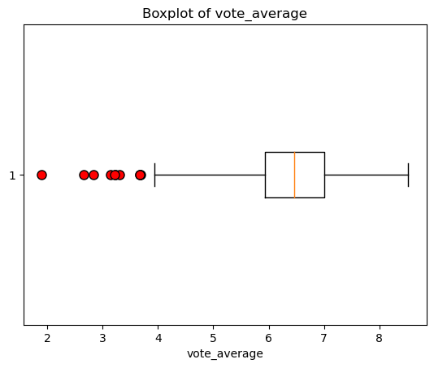
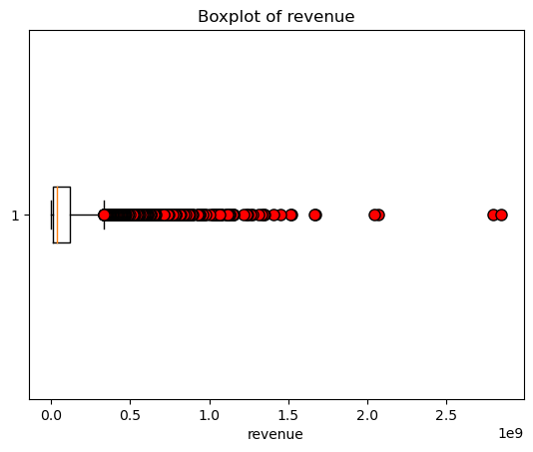
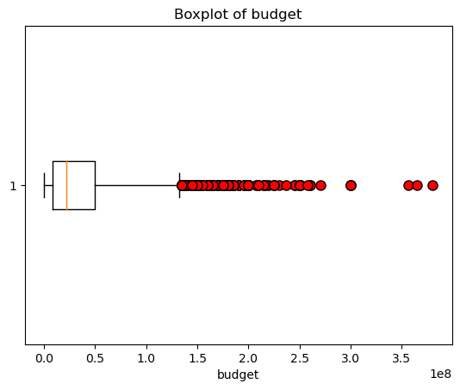
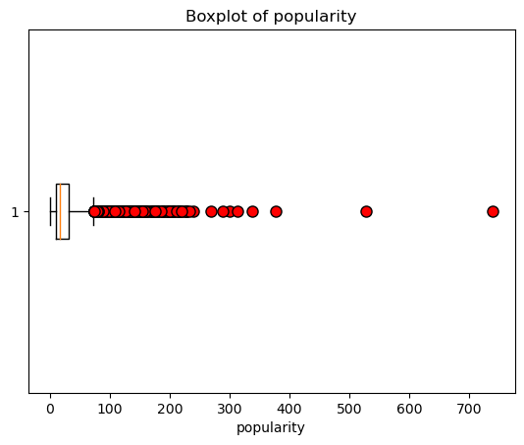
Outlier

Slide 12


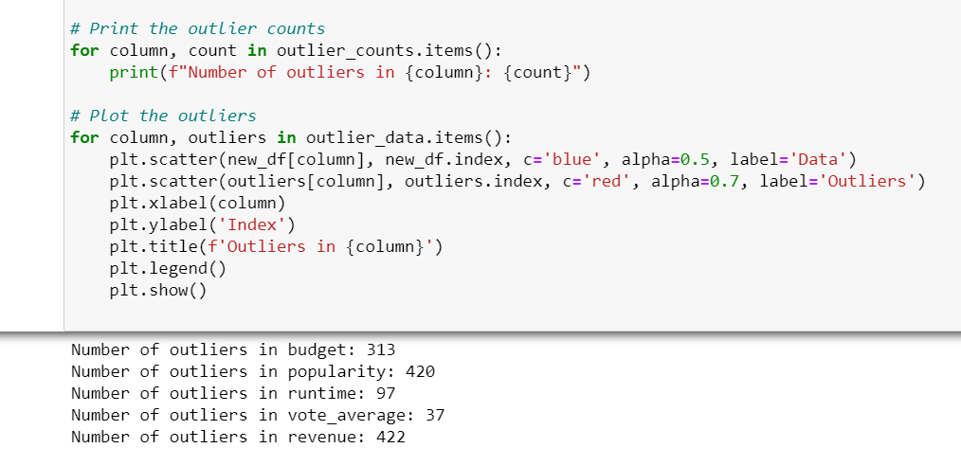

number of outlier

Slide 13


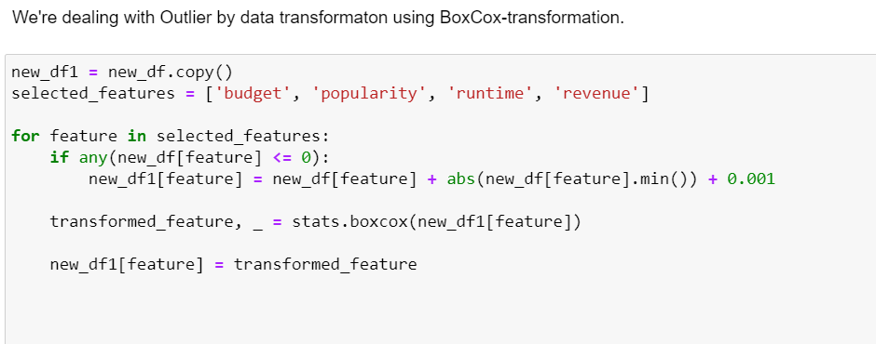
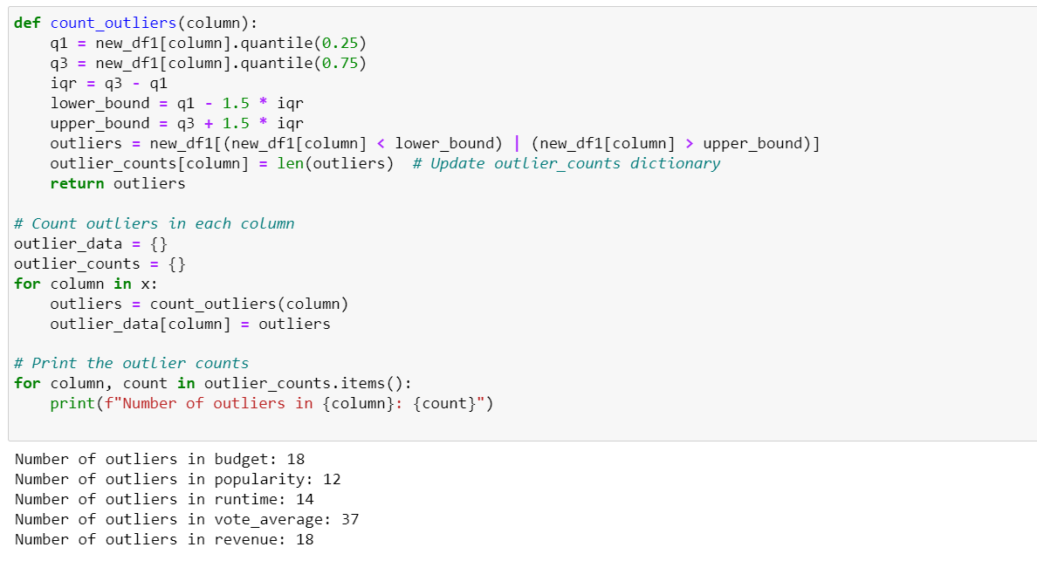
handle oulier
Present with ease and wow any audience with Canva.

Slide 14

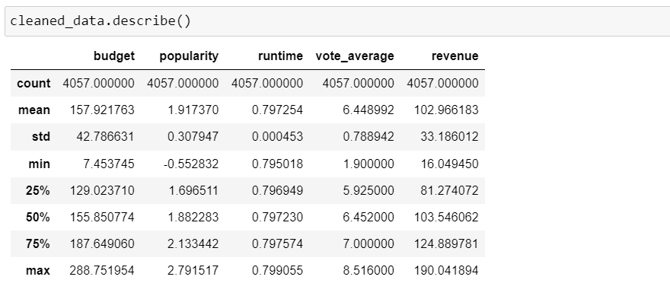

Visualize data

Slide 15
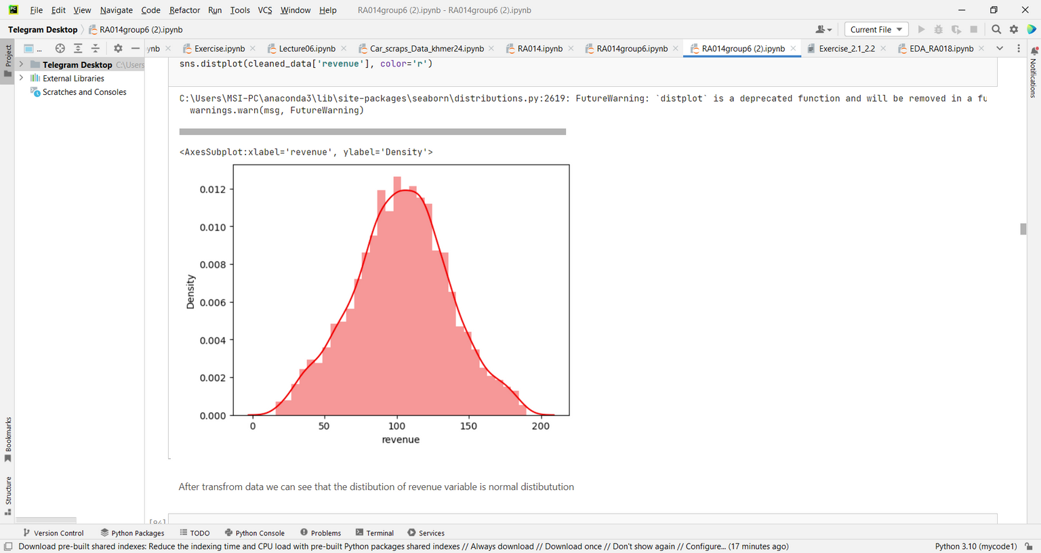
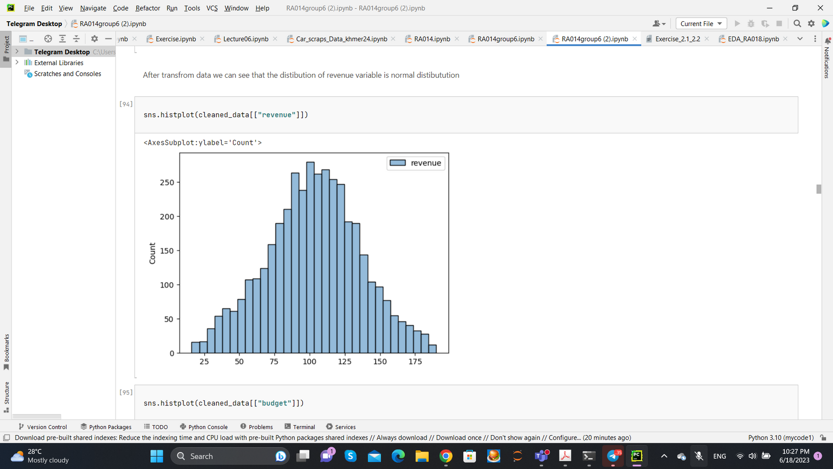
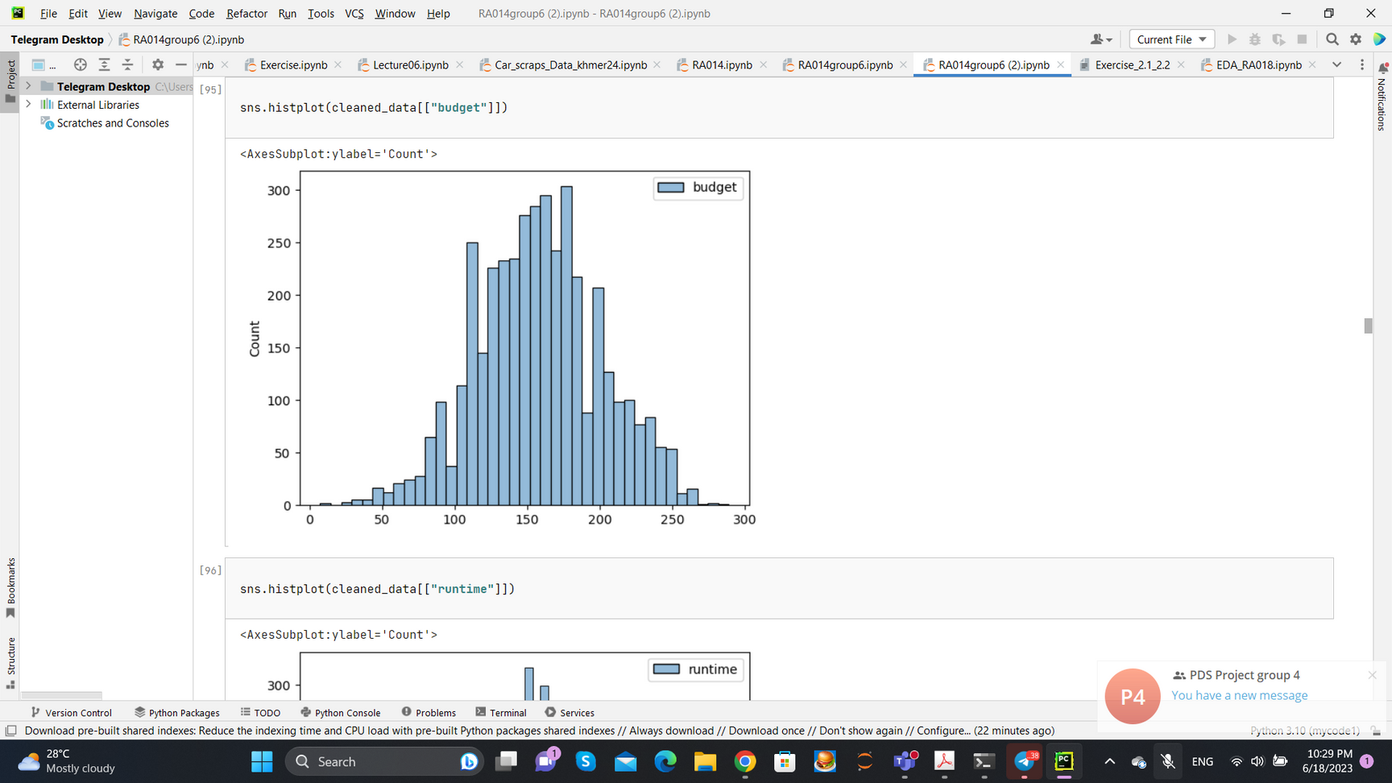
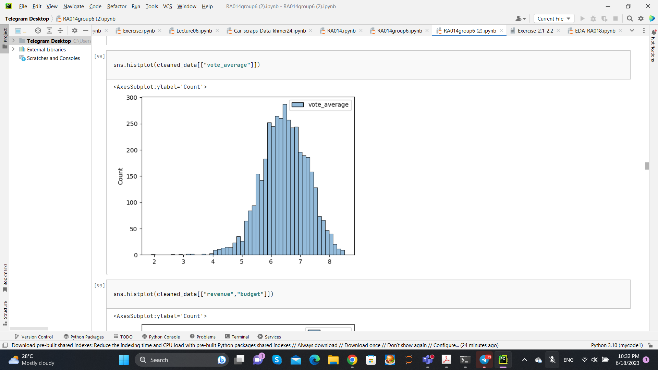
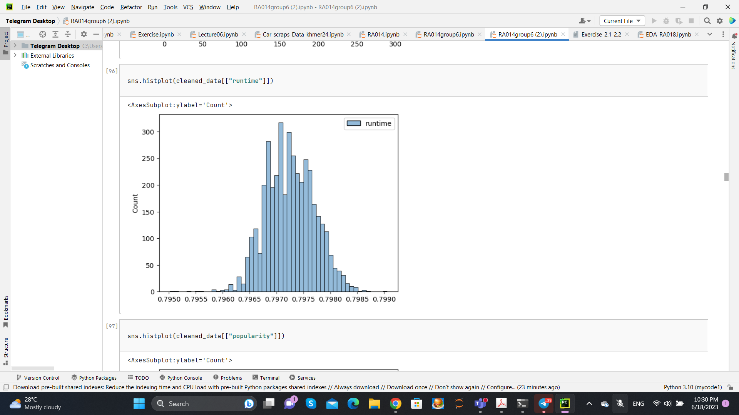
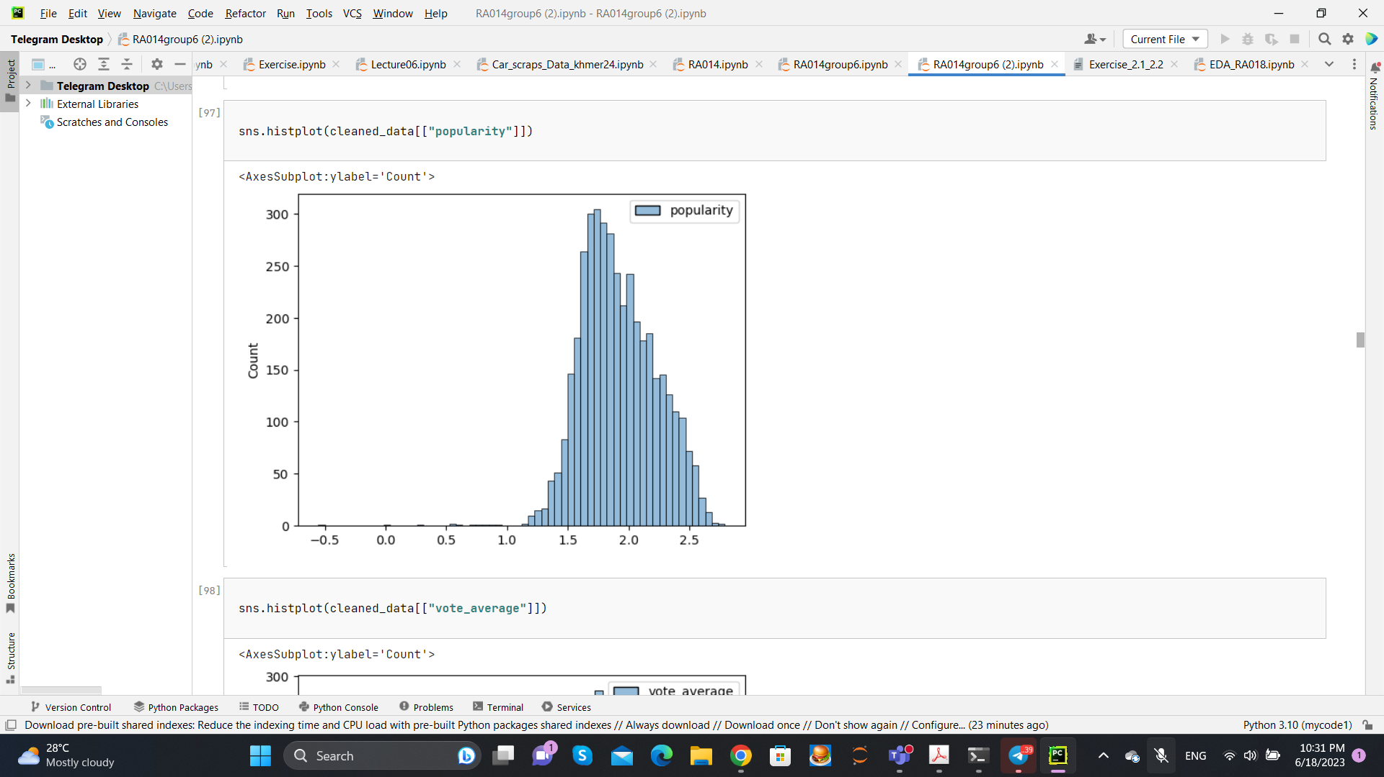
Visualize the Data

Slide 16


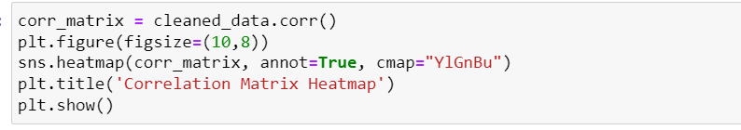
3. DATA ANALYSIS

Slide 17

Correlation

Slide 18
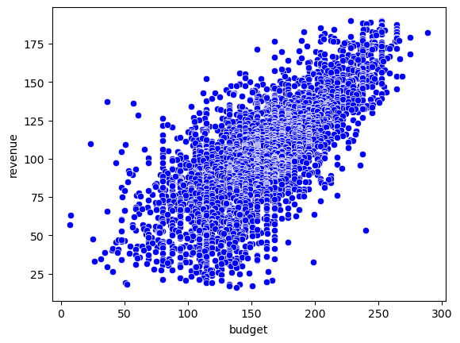
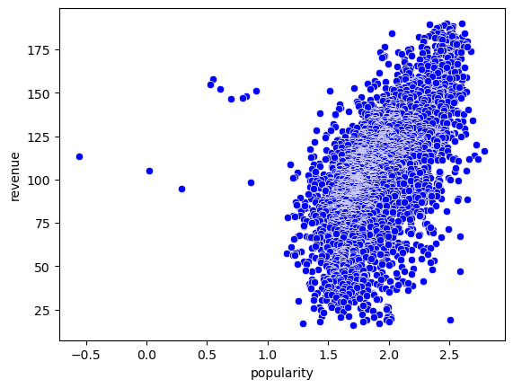

Slide 19
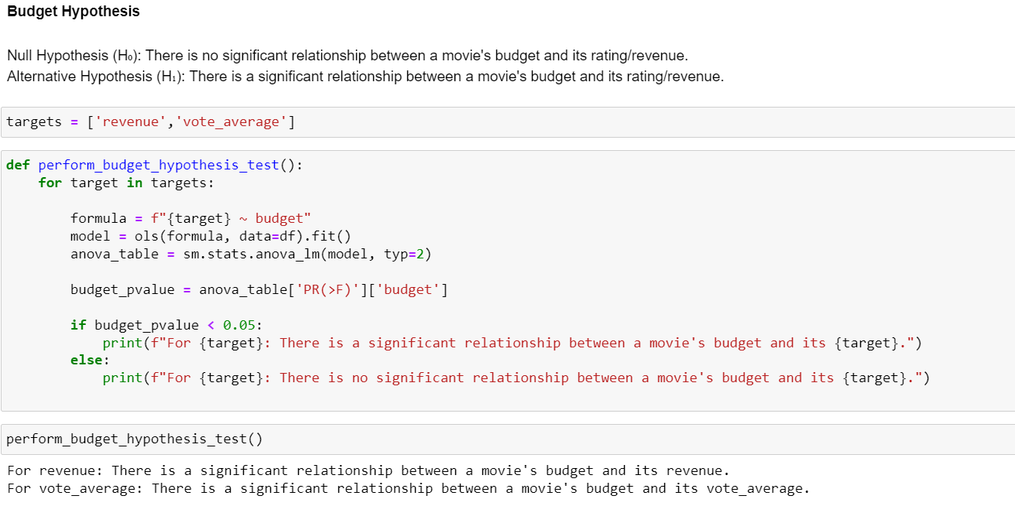


HYPOTESIS TESTING

Slide 20
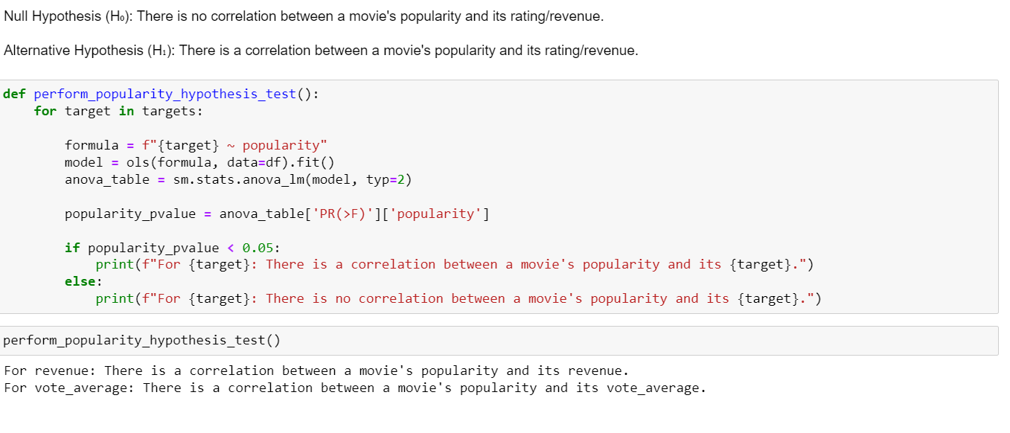

Slide 21
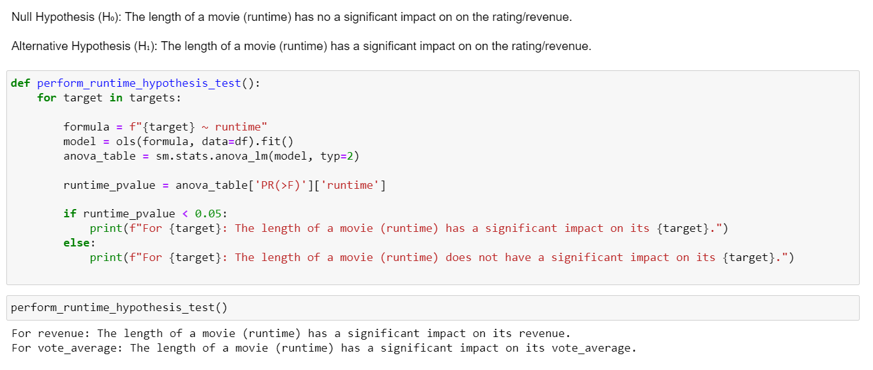

Slide 22
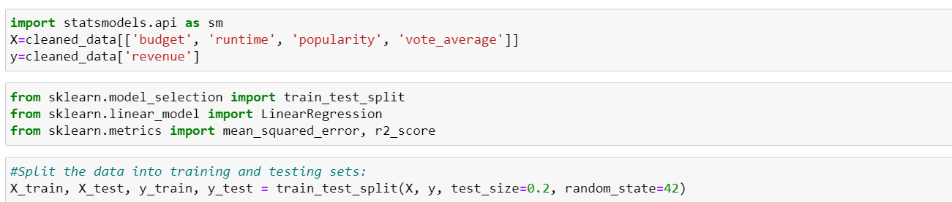


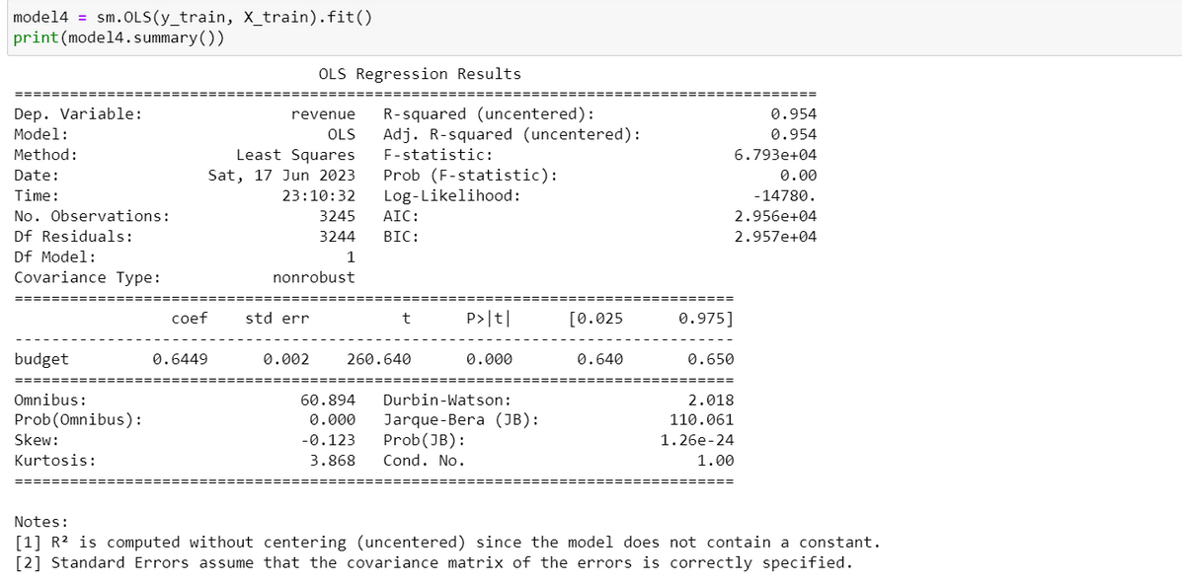
4.Methodology and Model
MODEL WITH FOUR FEATURE

Slide 23
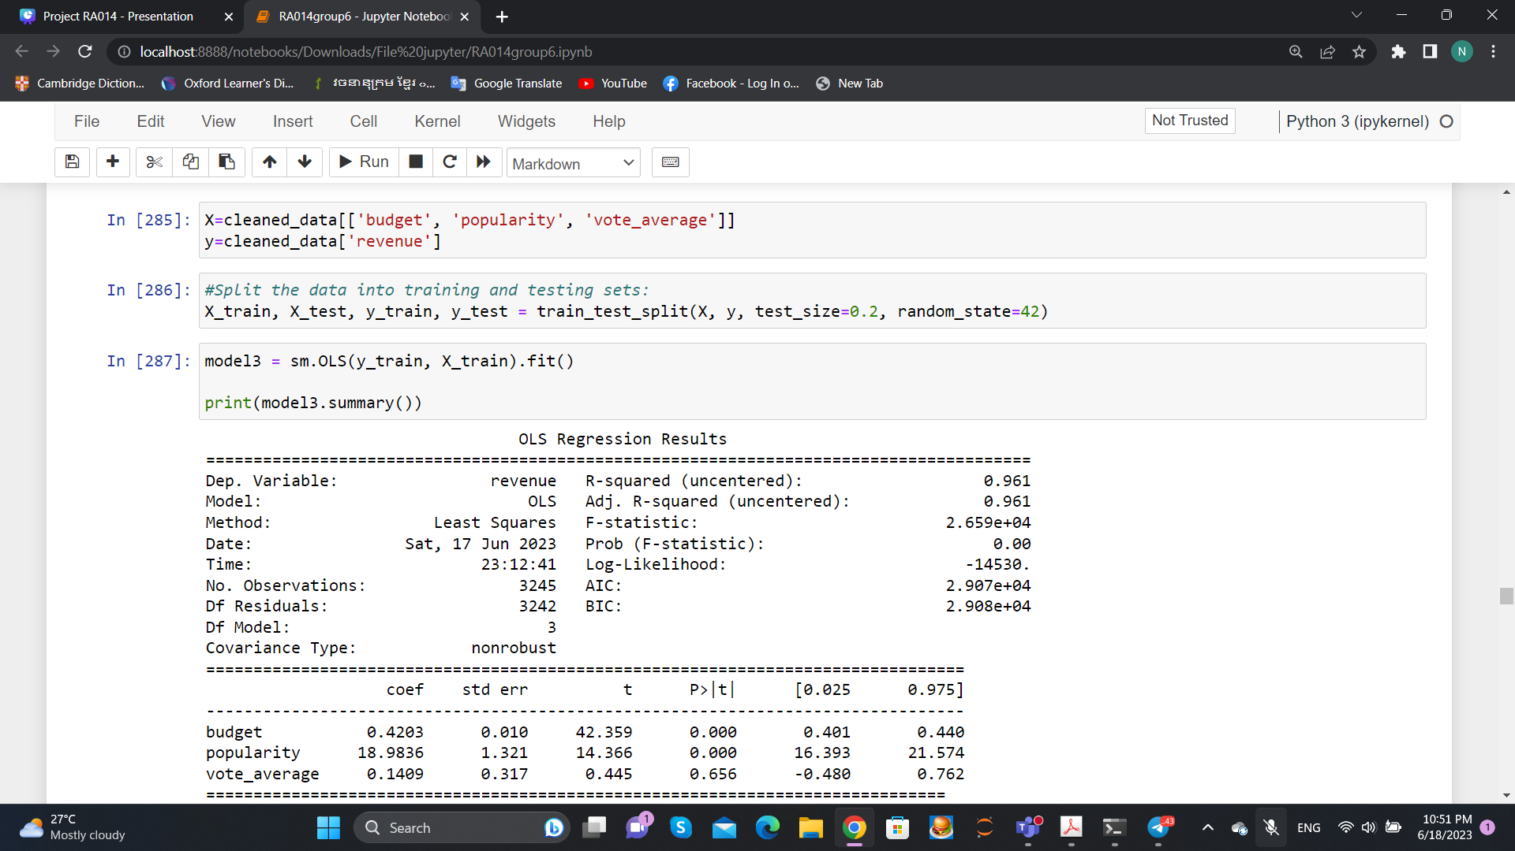
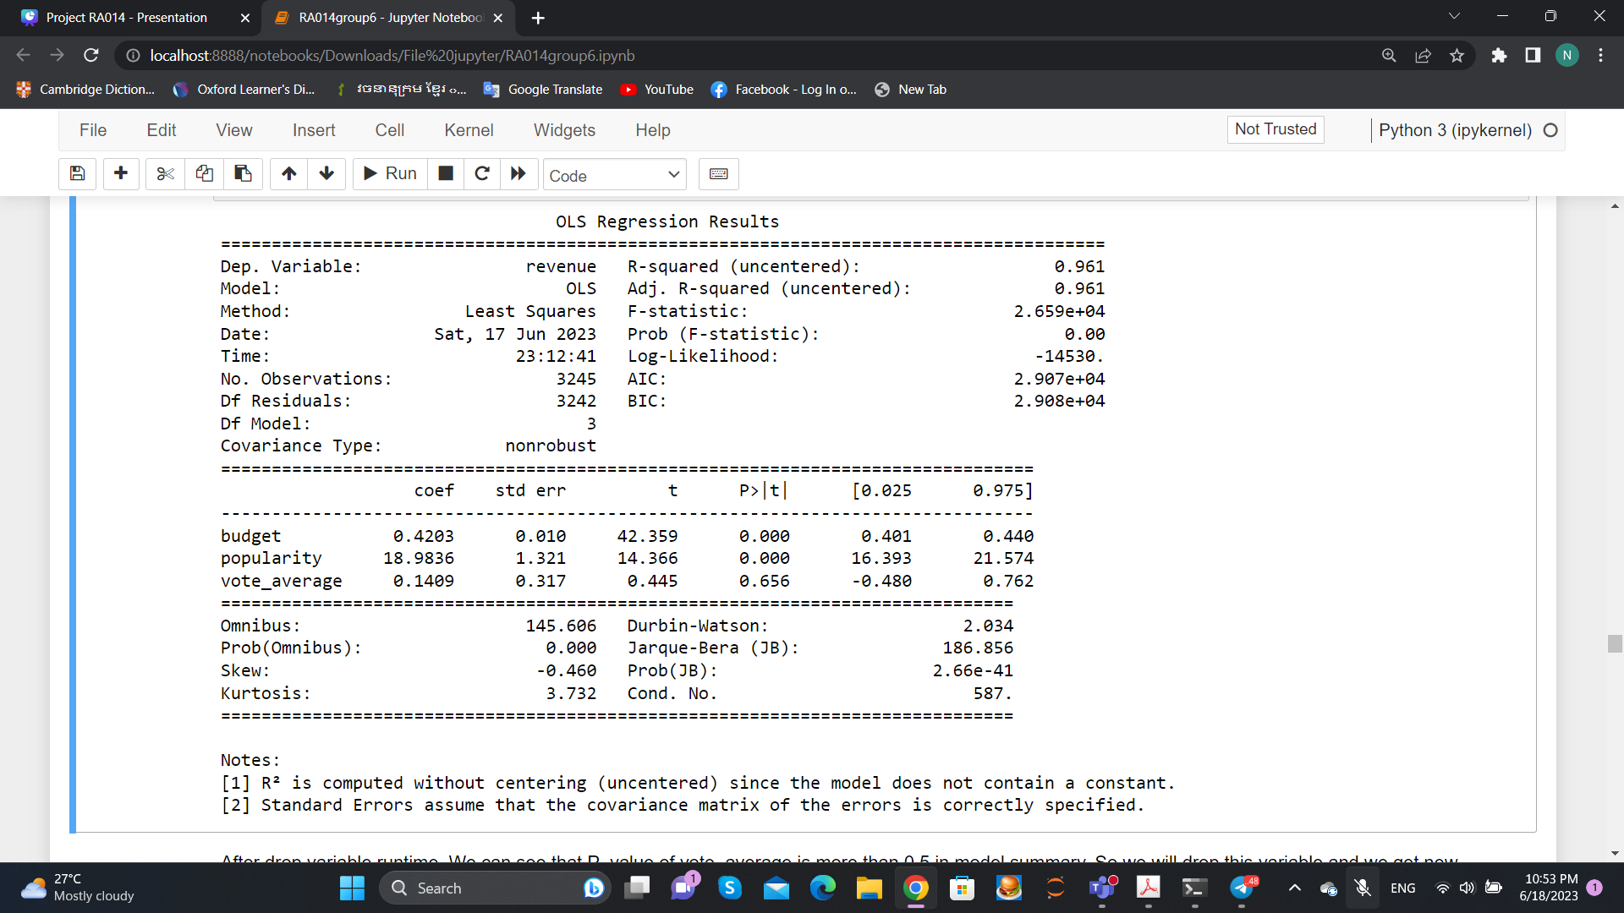
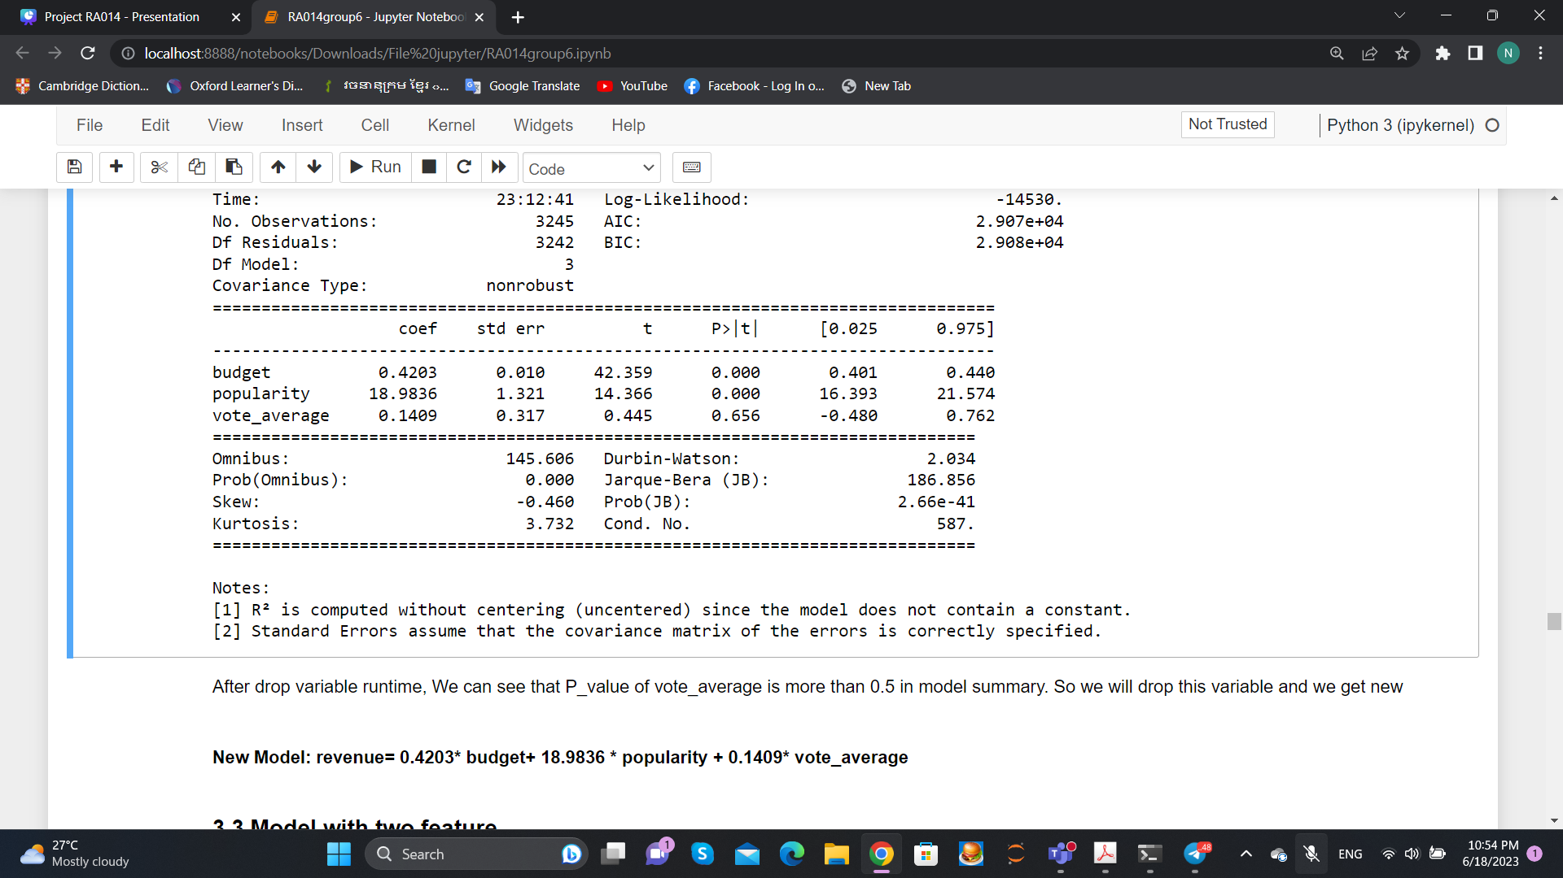
Model with three feature

Slide 24
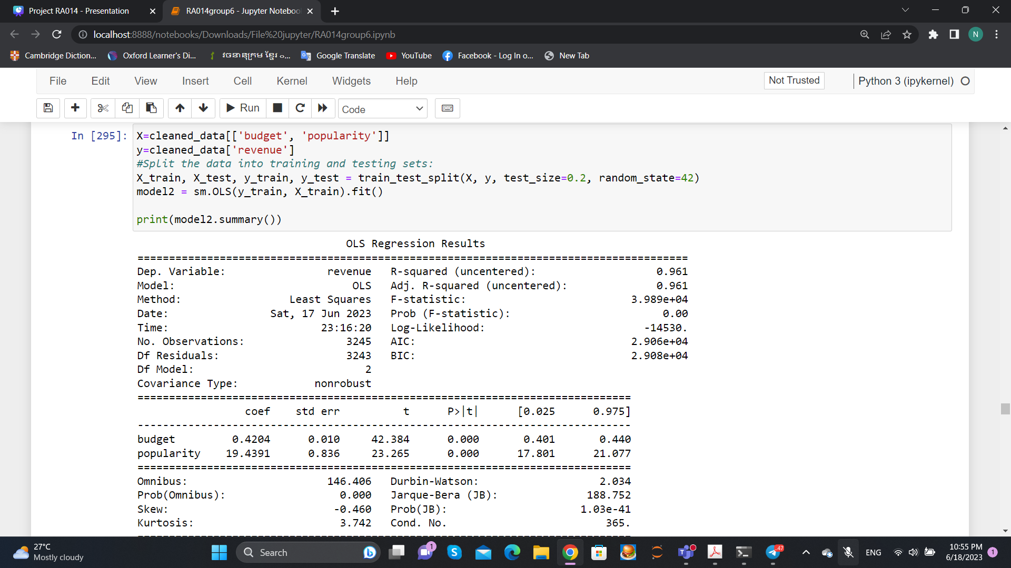
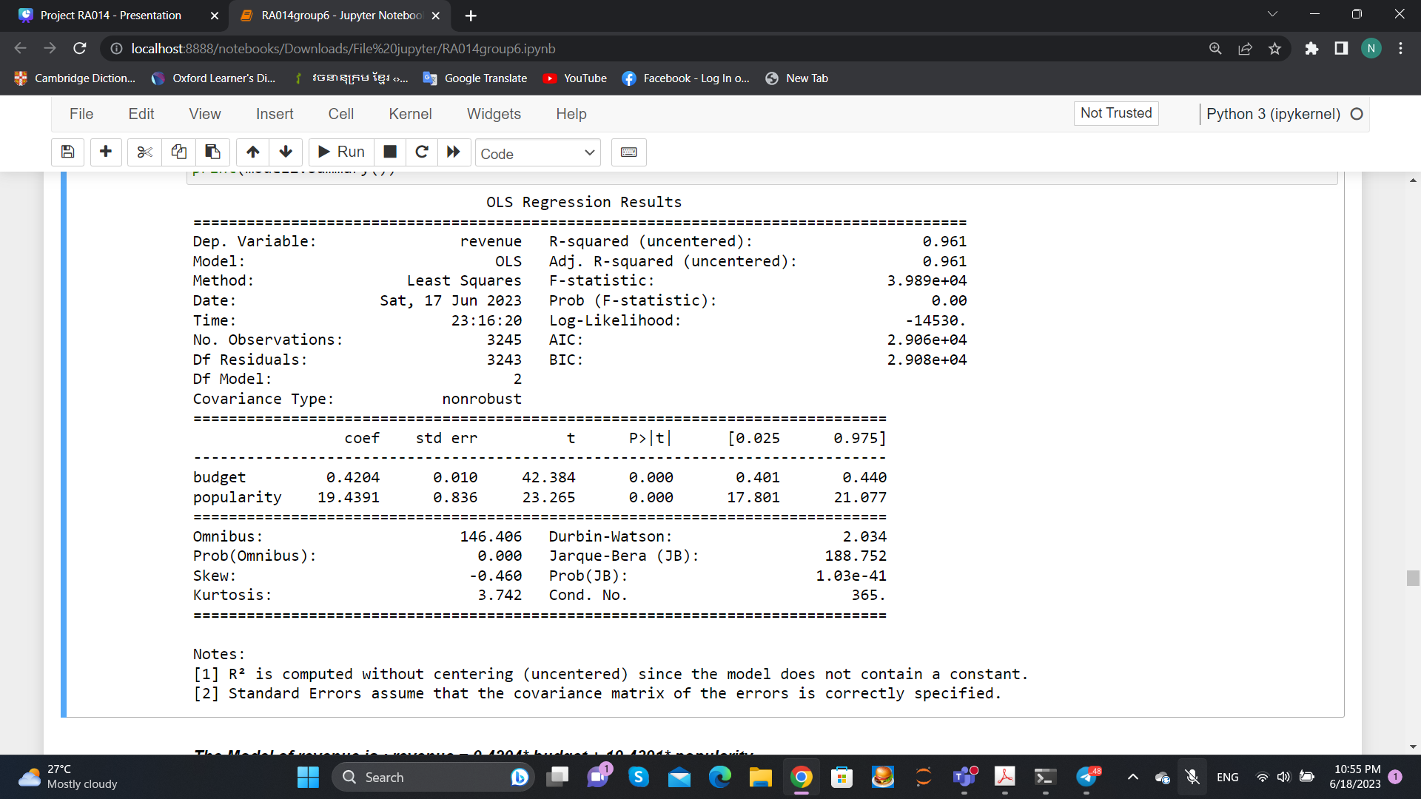
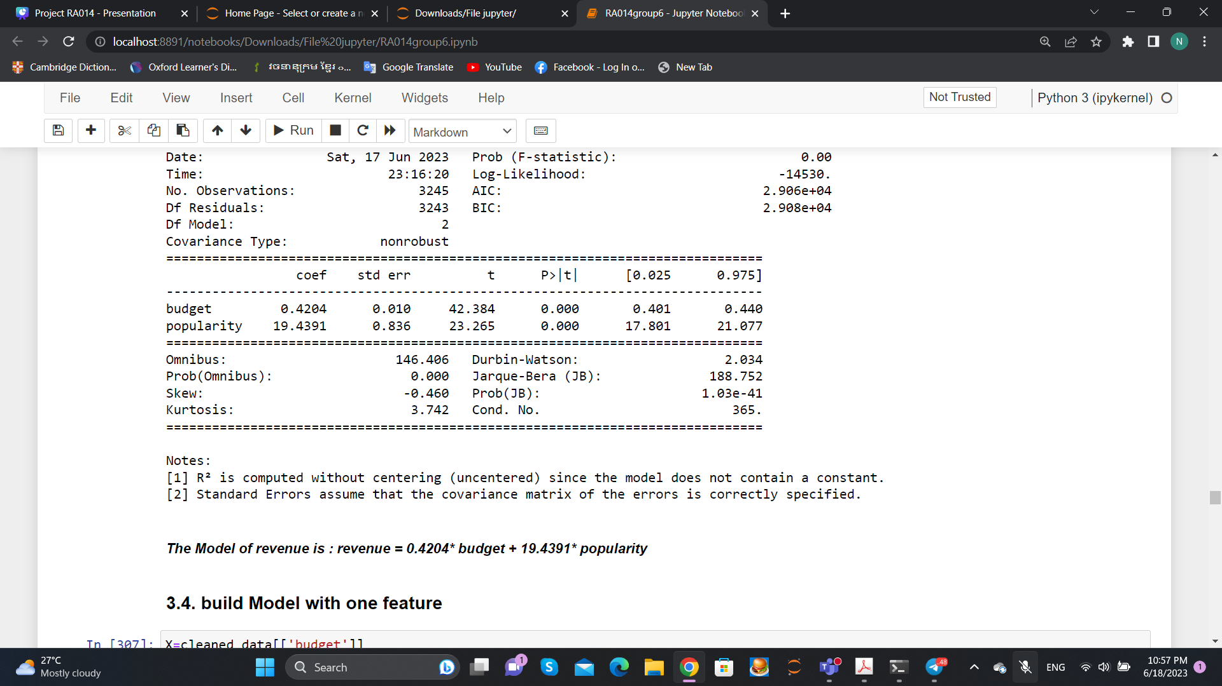
Model with two feature

Slide 25
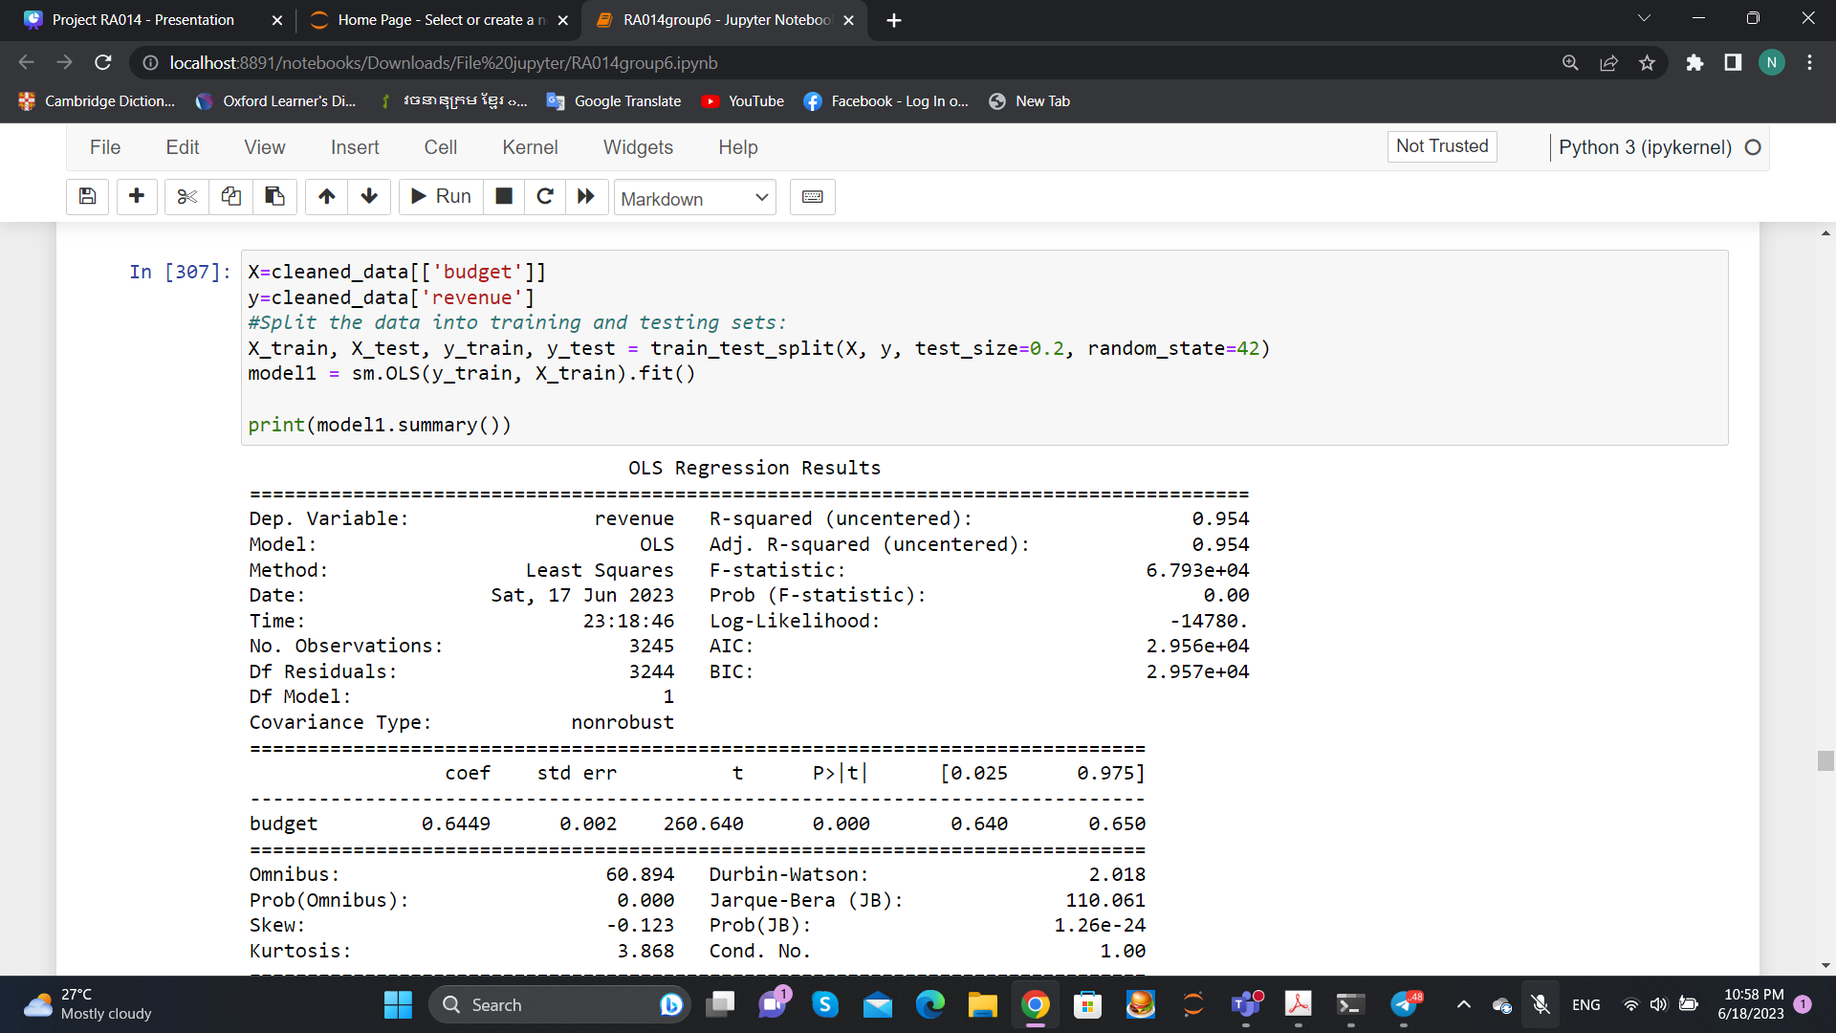
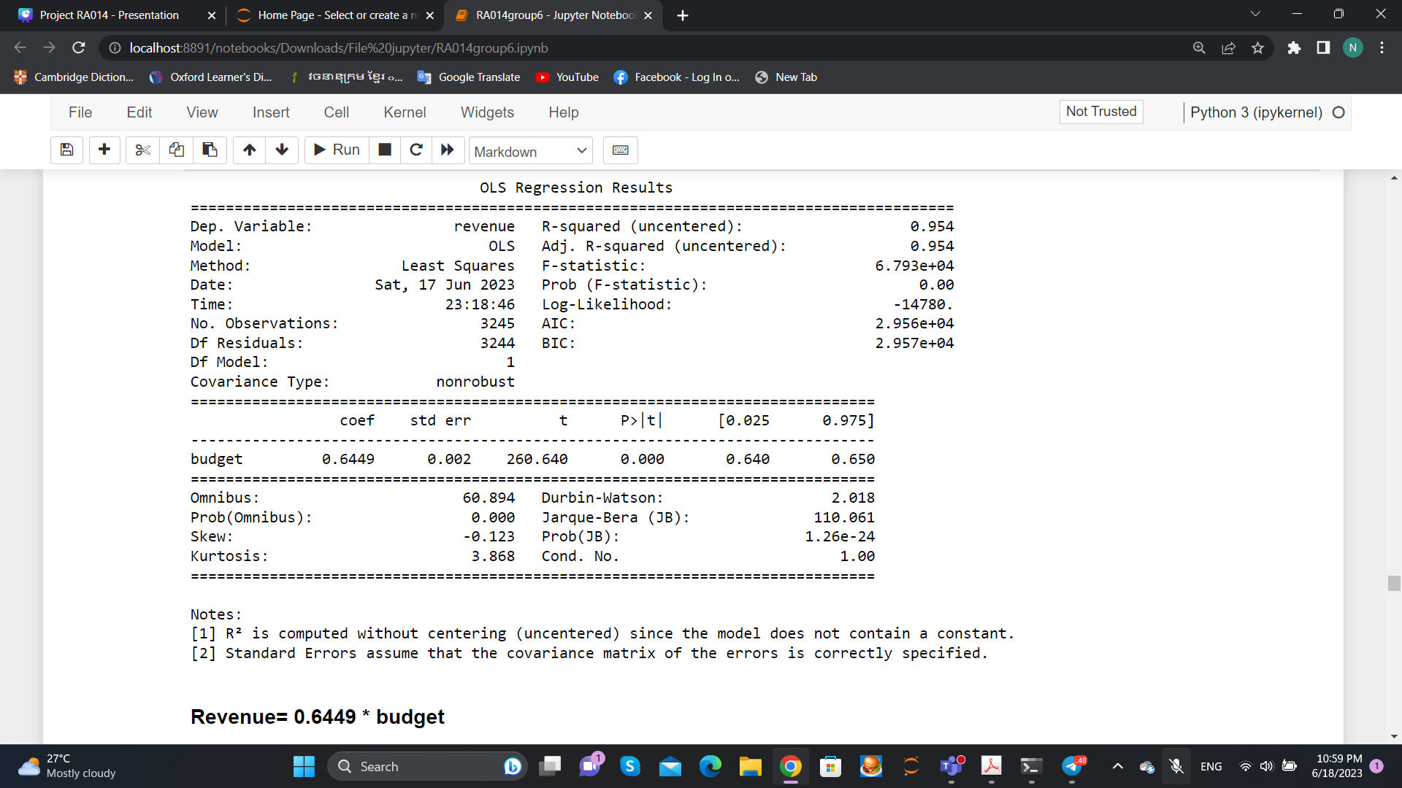
Model with one feature

Slide 26
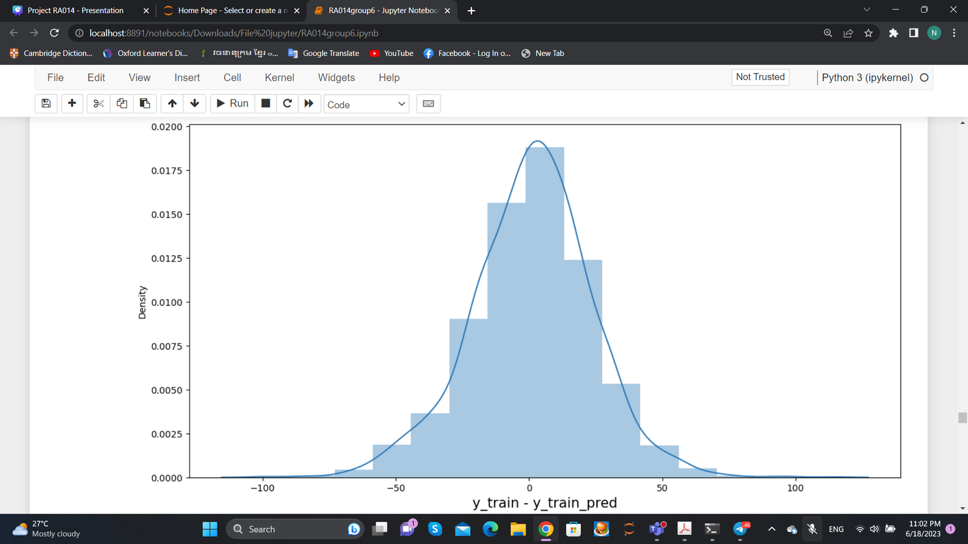
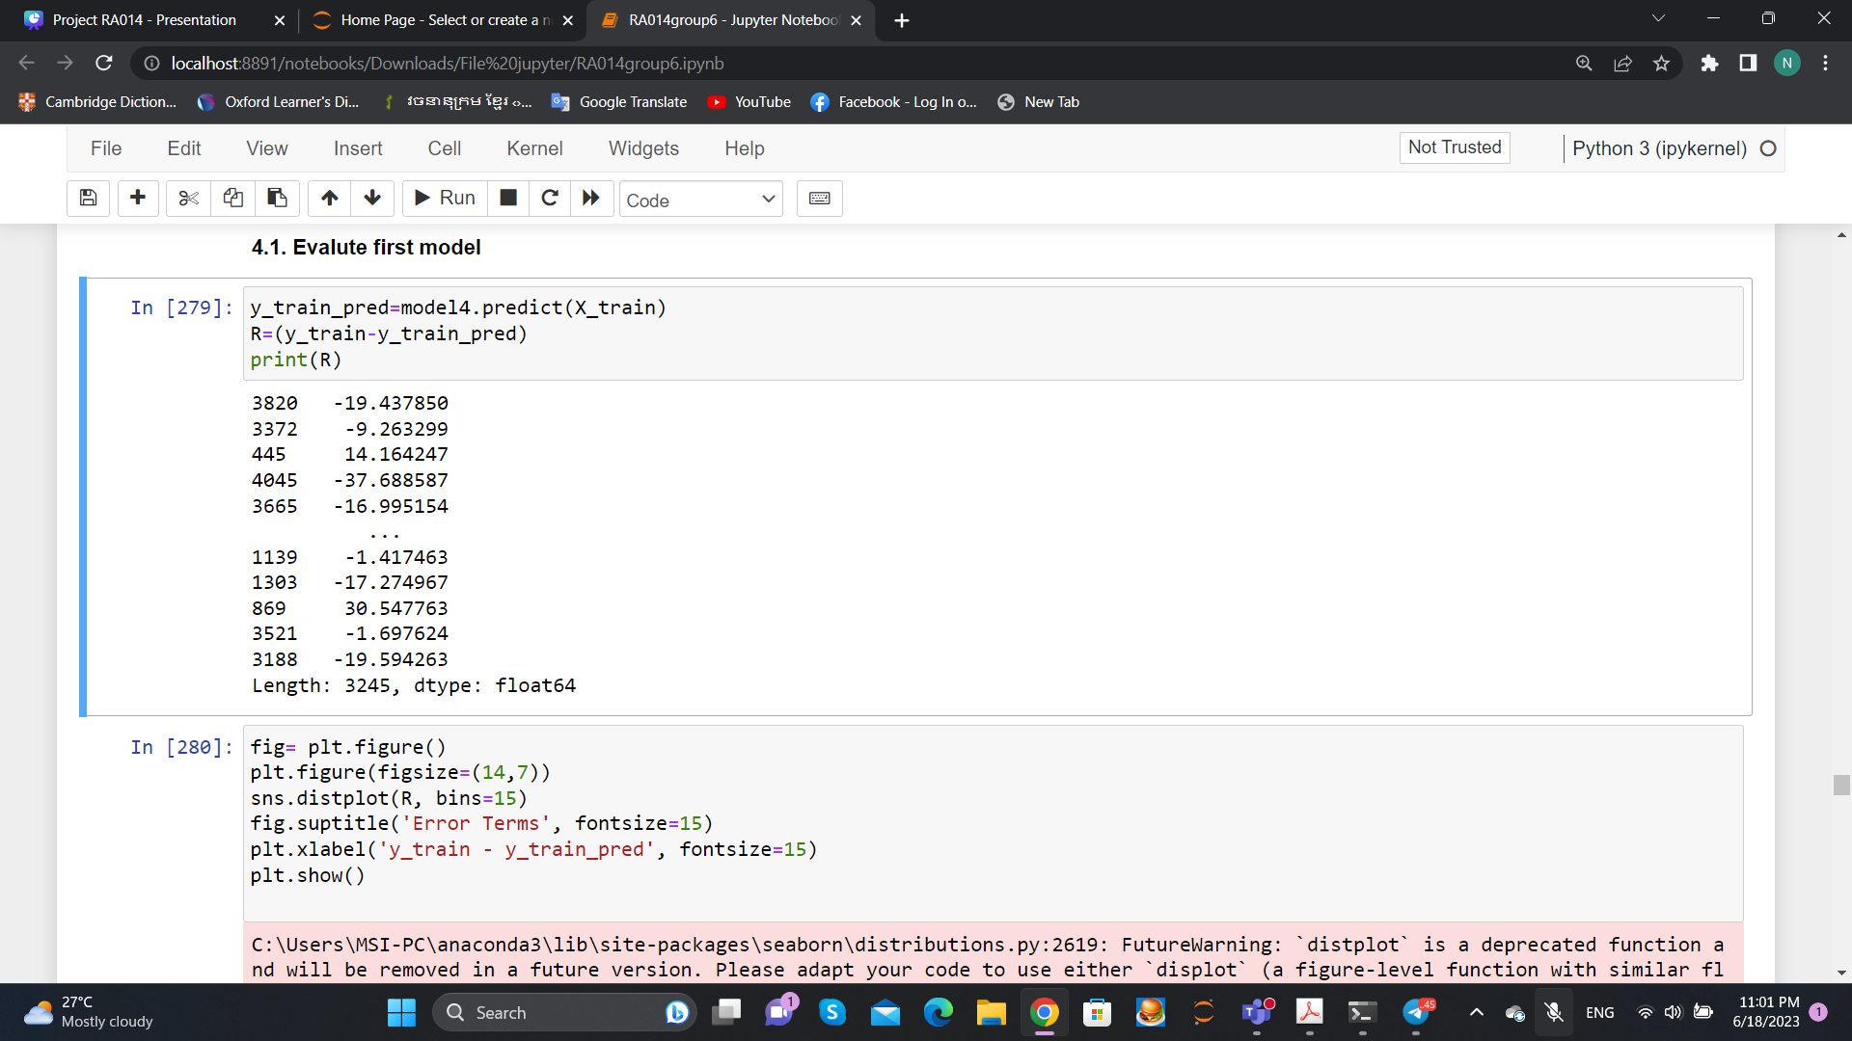
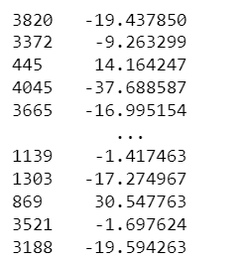
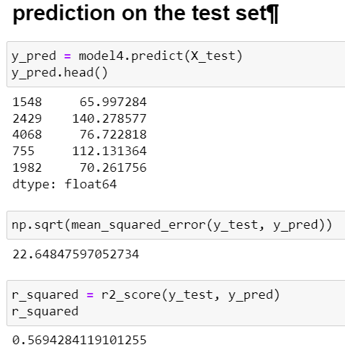
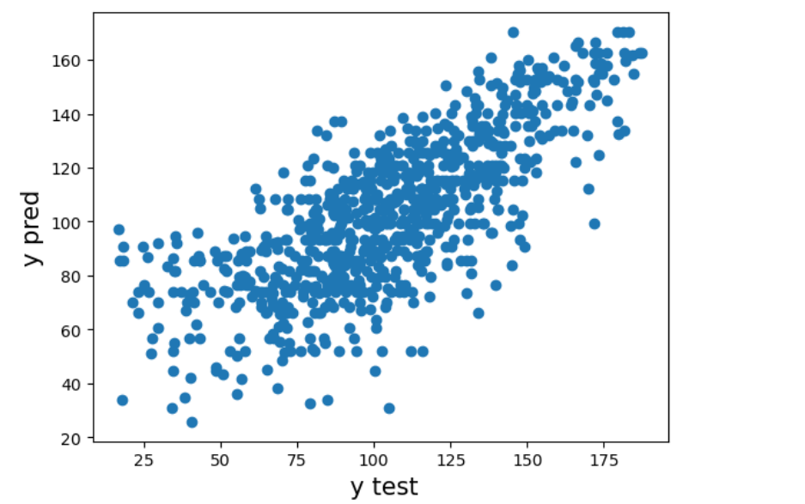
Evaluate first model

Slide 27
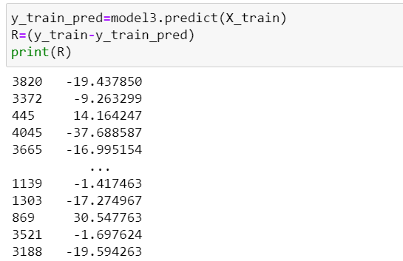
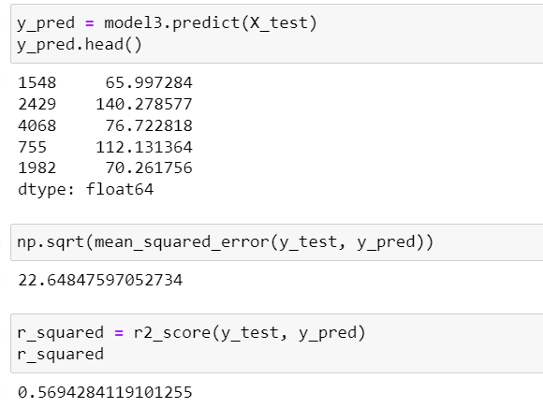
Evaluate secode model

Slide 28
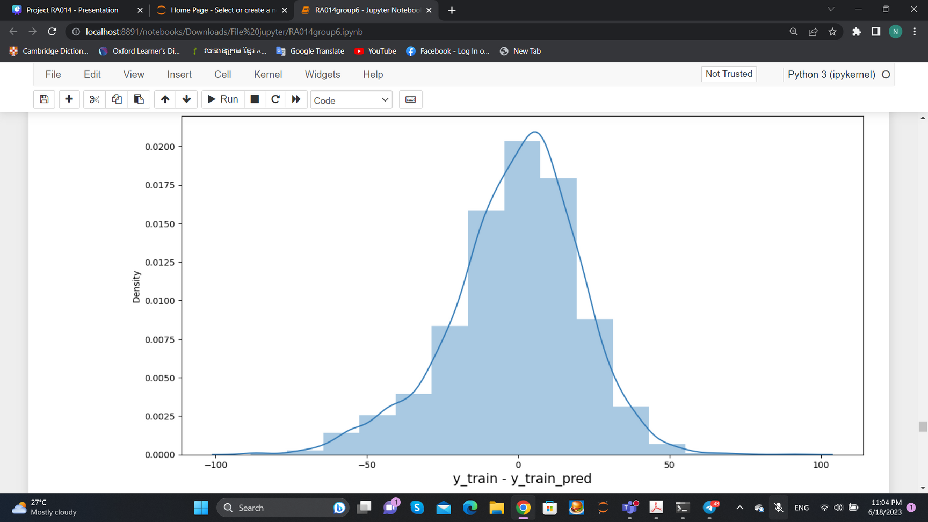
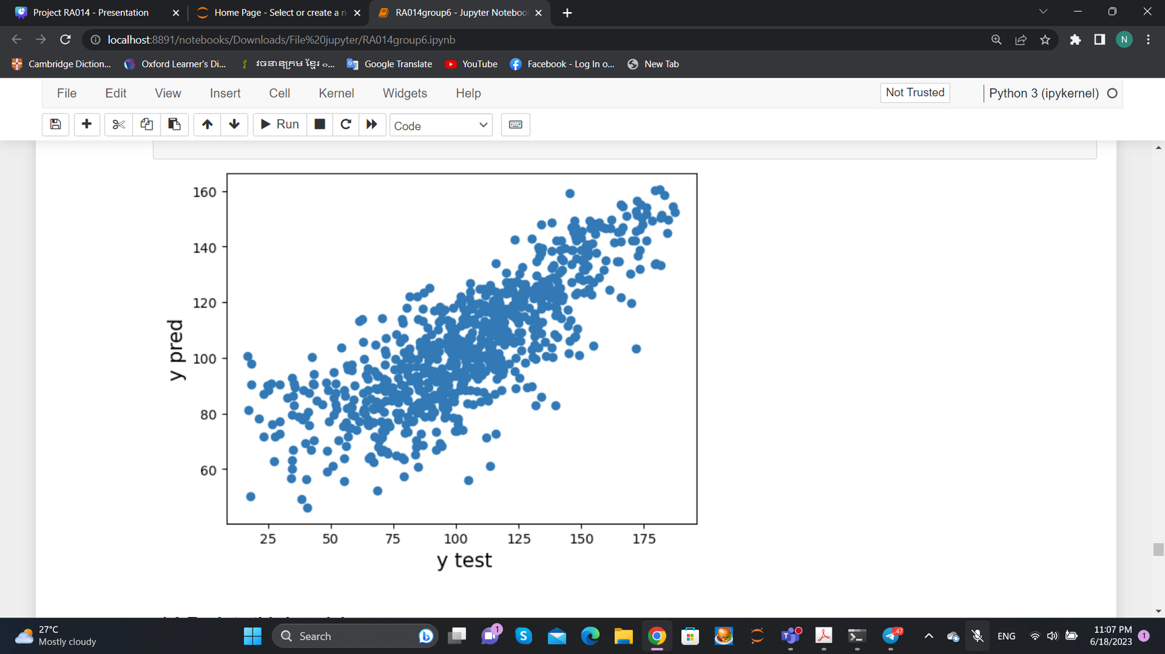

Slide 29
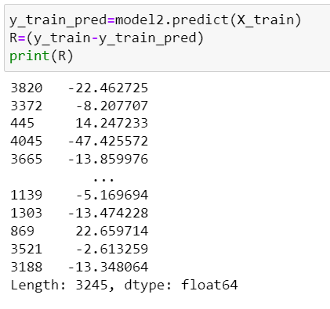
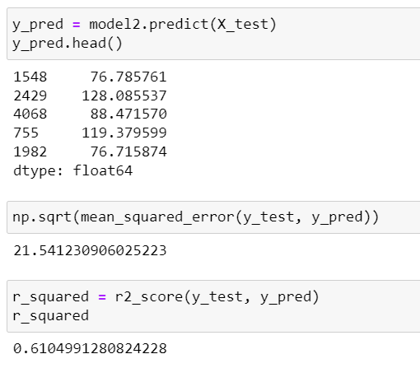

Evalute third model

Slide 30



Evaluate fourth model

Slide 31

Model Selection

Slide 32




CONCLUSION
it seems that a movie's revenue is likely to be influenced by both its budget and its popularity. Movies with higher budgets may have more resources available for marketing, production value, and talent, which could lead to greater audience appeal and ultimately higher revenues. Similarly, movies that are highly popular or anticipated may generate more buzz and attract larger audiences, leading to higher ticket sales and revenue. while it is reasonable to assume that budget and popularity can play important roles in determining a movie's revenue.
So your company have to think about the budget before you make a movie and the popularity with the background of movie.

Slide 33


